Slide 1






PetroPower Refinery Digital transformation
Name : Eman Gomaa Mabrouk
Student ID: 21031813
Email: eman_apc88@hotmail.com
NEXT81 _ONL1_ERP8_M1d
Notes:
ERP presenation

Slide 2
PetroPower Refinery
Digital transformation Project
A RoadMap to Success…
Who are we?
PetroPower Refinery
At Digi Future Solutions, we are a leading ERP implementation partner dedicated to transforming businesses through innovative technology solutions. With a steadfast commitment to excellence, we provide tailored services that empower organizations to streamline their processes, increase efficiency, and foster growth.
At Petro Power Refinery, we are dedicated to transforming crude oil into the essential fuels and products that power our world. With decades of experience in the petroleum refining industry, we have built a robust reputation for delivering high-quality refined products that fuel economies and power industries
Eman Gomaa Mabrouk
NEXT81 _ONL1_ERP8_M1d

Slide 3
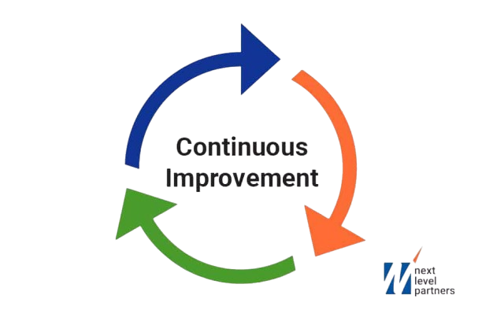
PetroPower Refinery
Digital transformation Project
Business Analysis
Project Initiation
Project Planning
Project execution
Project closure
Kick off meeting
Situation Statement
SMART Goals
WBS
OKRs
Critical Path
Fish Bone Analysis
Gantt Chart
Power Grid
Budget
SWOT Analysis
RACI Chart
Risk Management Plan
Project Charter
Communication Plan
Project Plan
Eman Gomaa Mabrouk
NEXT81 _ONL1_ERP8_M1d

Slide 4
PetroPower Refinery
Digital transformation Project
Situation Statement
A petroleum refining company PetroPower, is facing significant challenges in managing its operations, supply chain, as The current systems used for finance, inventory management, maintenance and Production are causing inefficiencies and data discrepancies which leads to delays in decision-making , Inefficient resource management & Decreased Productivity.
Need: To address these challenges and streamline operations, the company has decided to implement an integrated ERP system in collaboration with Digi-Future solutions , a leading company in digitalization processes and that’s to centralize data management, improve collaboration among departments, enhance visibility into key business processes, and ultimately drive better business performance , customer satisfaction & decision making“.
Inefficient Operations
Poor Decision-Making
Lack of Real time insights
Customers dissatisfaction
Over/Under Stocking
Low Profitability & Productivity
Increase in costs
Limitation in company’s growth
Effect
Impact
Eman Gomaa Mabrouk
NEXT81 _ONL1_ERP8_M1d

Slide 5







Manual Processes
Lack of Integration
No single, unified system to manage all aspects of the business
People
Time-consuming and error-prone manual processes
Poor Communication between Departments
Inefficient employee data management
Inadequate maintenance &asset management
Inadequate documentation & knowledge management
Lack of automation & workflow management
PROBLEM
Inefficient Operations
Poor Decision-Making
Low Profitability & Productivity
High procurement costs
No real time data & analytics
Outdated & unsupported systems
Delays in order fulfillment & delivery
Poor Data management & quality
Inefficient procurement & inventory management
Incompatibility with modern technologies and integrations
Inefficient reporting & analysis
MATERIALS
Limited functionality & scalability
Inadequate Data Visibility
Legacy Systems
FISHBONE ANALYSIS
Eman Gomaa Mabrouk
NEXT81 _ONL1_ERP8_M1d

Slide 6
Internal Factors
SWOT
-Top management support
-Employees expertise in business
-Strong financial profile
-Data Inconsistencies
-Processes complexity
-Manual processes
-Resistance to change
-Large customer base
-Company’s products are strategic
-Currency fluctuations
-Changes in Market demand
& Regulations
(Taxes, Accounting Standards)
Strengths
Weaknesses
Opportunities
Threats
External Factors
Eman Gomaa Mabrouk
NEXT81 _ONL1_ERP8_M1d

Slide 7





Digital transformation Project
S
Implement an ERP system that integrates all business functions, including finance, supply chain management, and operations management
SPECIFIC
M
Develop a comprehensive training program for 80% of employees to ensure a smooth transition to the new ERP system
MEASURABLE
A
Attainable
Reduce inventory costs by 15% within 12 months after successful implementation
R
RELEVANT
Implement an ERP system that is compliant with industry regulations and standards
T
Complete the ERP implementation project within 18 months
TIMEBOUND
Goals
Eman Gomaa Mabrouk
NEXT81 _ONL1_ERP8_M1d

Slide 8
OKRs for the project
Combines GOALS & METRIC to determine Measurable outcomes
Objective
Objective
Objective
Improve data management and analytics
Ensure user adoption and training
Implement ERP system to improve operational efficiency
Key Results
Key Results
Key Results
Standardized Process and speed up workflow within the 6 month
Develop a hand on- training for Key users for 1 month
Increase Master data accuracy by 80% within 6 months
Increase inventory accuracy by 30% within 3 months
Establish a support team to provide ongoing assistance to end-users.
Develop 10 key performance indicators (KPIs) to measure operational efficiency within 3 months
Eman Gomaa Mabrouk
NEXT81 _ONL1_ERP8_M1d

Slide 9
PetroPower Refinery
Digital transformation Project
Stakeholders' analysis
&
Power Grid
Identification of Key Stakeholders, Their involvement and their impact on the project
Facilitates creation of tailored communication plan
Involve right PEOPLE at right TIME
Determines Stakeholders level of
Influence
Interest
Measure Level of POWER over project outcome
How Much stakeholders’ NEEDs are affected by the project
Eman Gomaa Mabrouk
NEXT81 _ONL1_ERP8_M1d

Slide 10
Stakeholder | Role (Related to project) | Involvement | Impact | Power or Influence (H/M/L) | Interest (H/M/L) | Engagement
-CEO -Steering committee | -Financial Supporter Project Sponser | Makes high-level decisions; serves as team resource -provides strategic guidance | -Wants the project to succeed. No resistance. | H | H | Communicate regularly, but not daily. Ask questions and give updates.
-Business process owners -Functional team | -Project team members | -Provides Business processes and ensure system meets business requirements -Gather requirements, modules configuration. | -Invested in the project as a team member. Possible resistance if their roles are affected. -Alignment with Business Need reduce adjustment and delays | H | H | Communicate daily as project team member
-Customers -Governmantal parties | -Petro Power customers -External parties | -Can give feedback on the customer experience -Ensure system are alligned with regulations | -Some highly interested; others less so. Resistance only if affects main product specs. -Resistance if regulations are not met | H | M | Communicate as needed to inform and get feedback.
-Endusers -Training team -Support team | -Petro Power Employees training end-users before Go-Live | -End users for system -Delivers training programs to end-users | Little impact at present. ensure End users are ready to use the ERP system effectively | L | H | Not directly involved. Keep updated on progress and performance.
-Internal security team | -Petro Power internal Audit team | -ensure regulations are followed | -Little impact on their role. No resistance. | L | L | Not directly involved, but should be updated before launch
PetroPower Refinery

Slide 11
Prioritizing stakeholders (Power grid)
high
Keep satisfied (high priority)
Manage closely (high effort)
Existing Customers
CEO
Steering Committee
Business process owners
Governmantal parties
med
Power
Monitor (minimum effort)
Show consideration
Internal security team
End users
Training Team
Support team
low
low
med
high
Interest

Slide 12

Project RACI Chart
Importance of RACI Chart
Workload Balance & Better Resources allocation
Clarifies Roles and Responsibilities
Improves Communication
Defines who is responsible for what tasks during project
Ensure that the right people are focused on the right tasks.
Avoid overloading a single stakeholder
Ensures that everyone is aware of their responsibilities and the progress of the project.

Slide 14
Project Charter
A document that consolidates all details of the project, including goals, scope, deliverables, success criteria, stakeholders, and resources.
Scope
Goals
Success criteria
Project Charter
Deliverables
Stakeholders
Resources

Slide 15
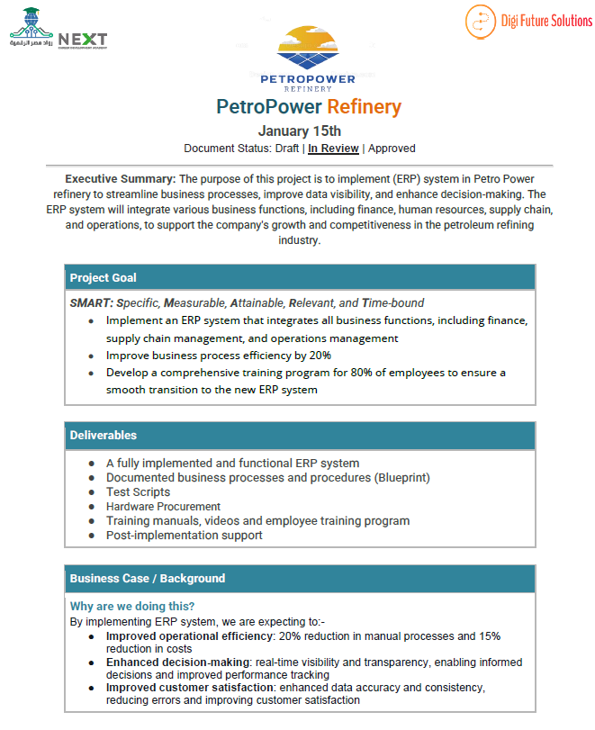
Project
Charter

Slide 16
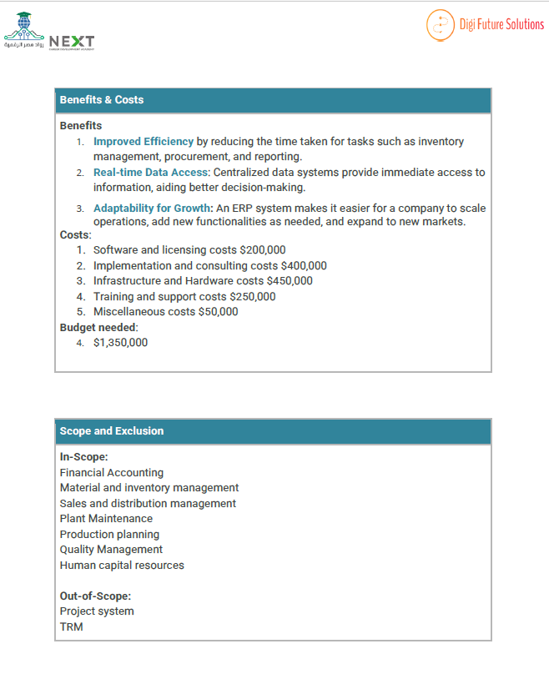
Project
Charter

Slide 17
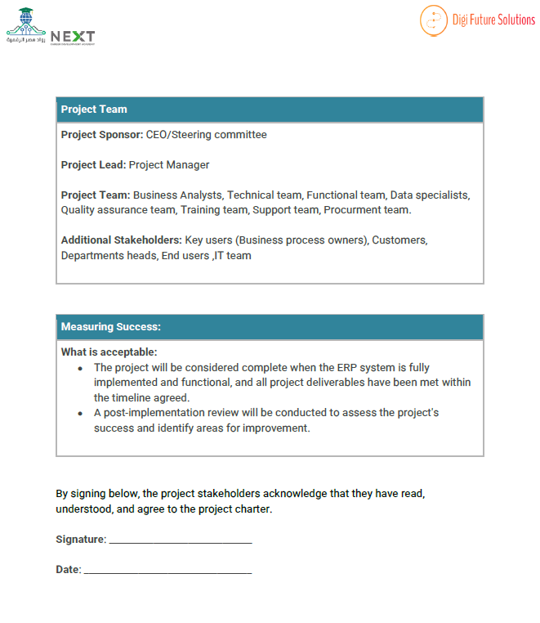
Project
Charter

Slide 18
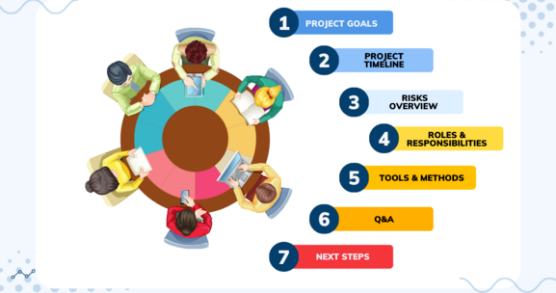
Project Kick Off meeting
Eman Gomaa Mabrouk
NEXT81 _ONL1_ERP8_M1d

Slide 19
Work Breakdown Structure
A visual tool that organizes and breaks down a project into :-Milestones , Tasks & Sub-tasks.
-100% Rule
-Mutually exclusive tasks
Project
Milestone A
Task1
Task 2
Milestone B
Task 1
Sub Task
Sub Task
Sub Task
Sub Task
Sub Task
Task 2
Sub Task

Slide 20
Project Work Breakdown Structure

Slide 21
Critical Path for Project

Slide 22
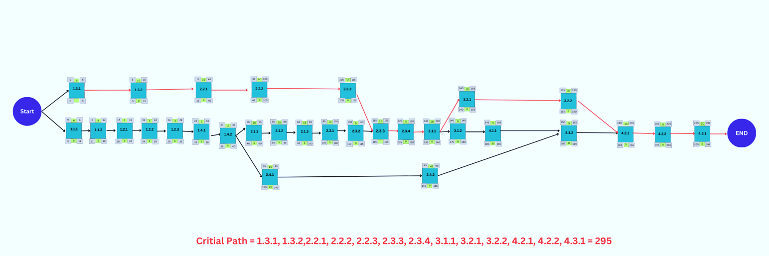
the Longest sequence of dependent tasks and their duration, to determine the Shortest time necessary to complete a project
Critical Path for Project
ES
EF
LS
LF

Slide 23
Budget Plan

Slide 24
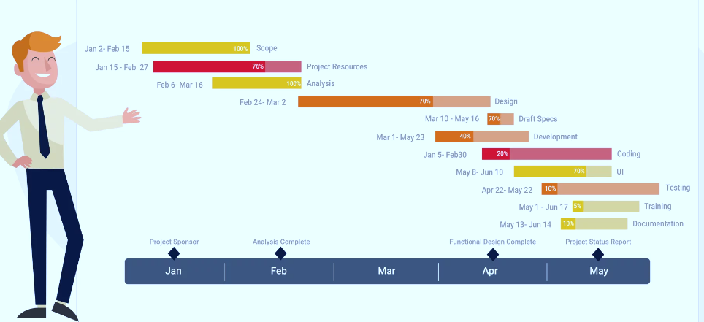
Gantt Chart
A powerful project management tool that can improve coordination, communication, and decision-making throughout the project lifecycle.
Visual Representation
For Tasks and Timelines
Resources allocation
To prevent team overloading
Benefits of Gantt Chart
Progress Tracking
Monitor if the project is on schedule or if adjustments need to be made.
Better Communication
with Team and Stakeholders
Gantt Chart for PetroPower Refinery project

Slide 25
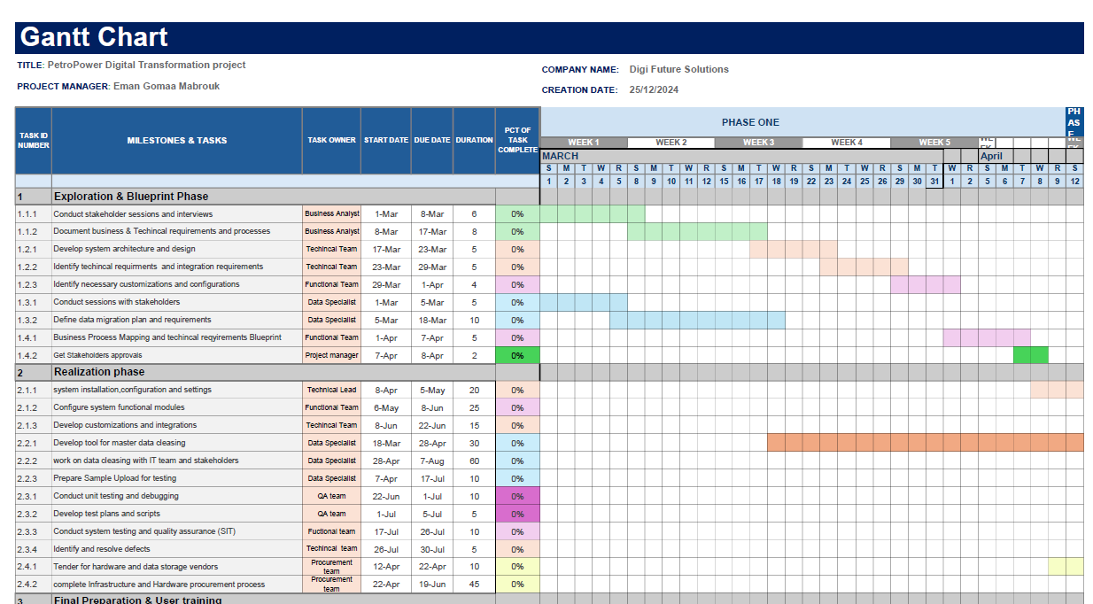

Slide 26

Risk Management Plan
Identify
Analyze
Evaluate
Treat
Monitor & Control
A Document that help Identify, Analyze, Evaluate, Treat and control risks throughout a project
Risk Management life cycle
Define
Potential risks
Assess
Impact & probability
Which risk require immediate action
Develop mitigation plans
Assign team members to track risk as they arise
It serves as a roadmap for how risks will be handled by Mitigation plans ,to minimize their potential impact on the project's objectives

Slide 27
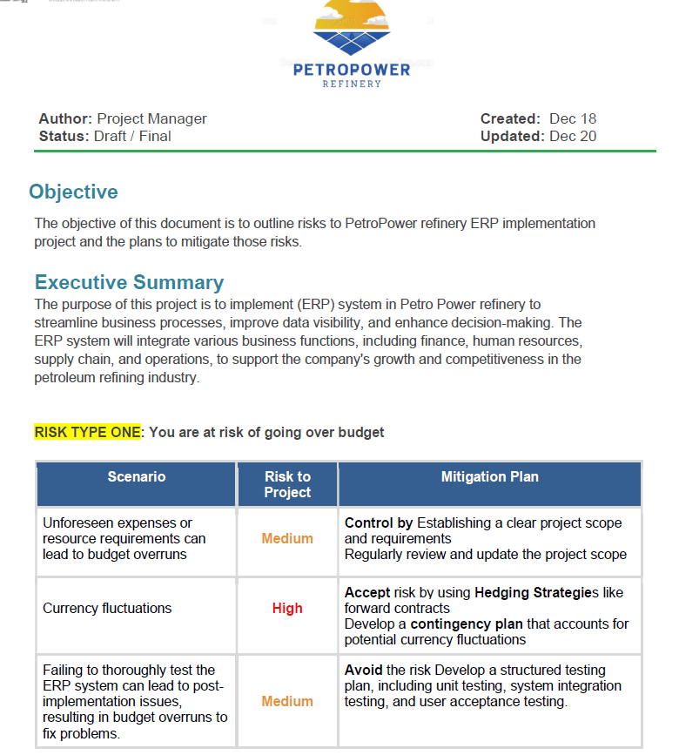
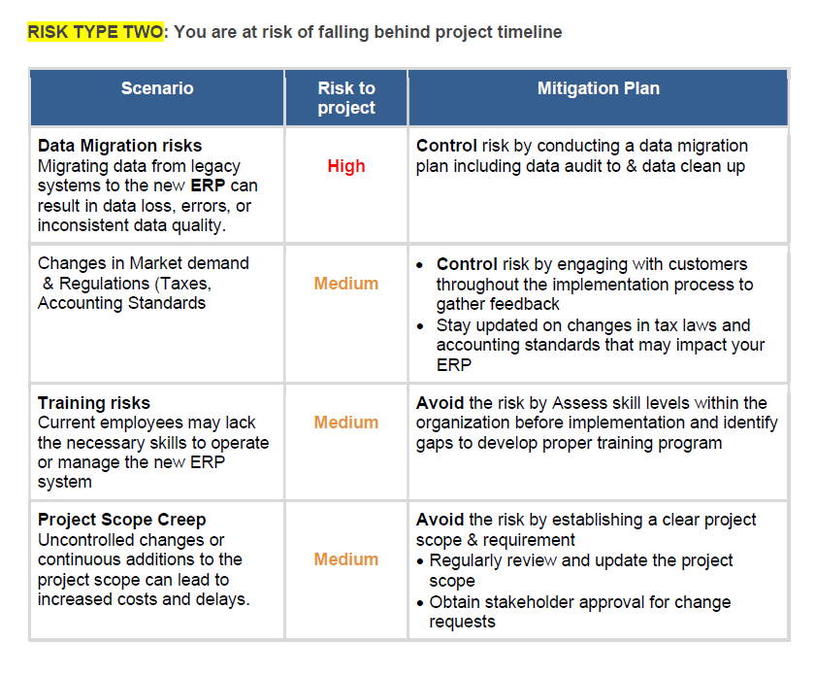

Slide 28

Communication Plan
A Document that outlines How Information will be shared among stakeholders throughout the project lifecycle.
It specifies the Methods, Frequency, Channels & Responsibilities for communication

Slide 29
Training Communication Plan

Slide 30
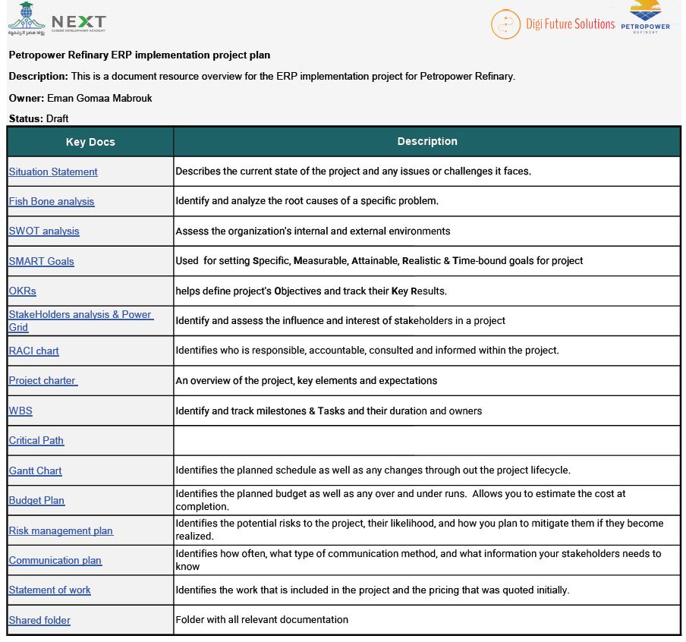
Project Plan

Slide 31
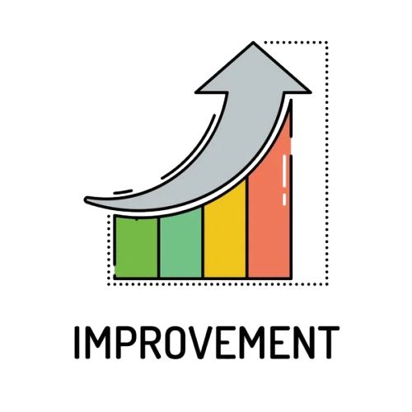
Post Implementation Review & Continuous improvement
1
Conduct project review & lessons learned
3
Develop plan for future enhancements and support
4
Regular Training and Development
2
Technology Upgrades and Innovations
5
Develop KPIs relevant to the ERP goals
User adoption rates.
Process efficiency improvements.
Cost reductions.
Customer satisfaction scores.
Document lessons learned from both the successes and failures during the implementation. This could include:
Best practices adopted.
Issues that occurred and how they were resolved.
Implement ongoing training programs for users to adapt to updates and new functionalities.
Stay informed about ERP technology advancements and assess their potential benefits.
Plan for regular upgrades or migrations to newer versions or platforms as needed.
Eman Gomaa Mabrouk
NEXT81 _ONL1_ERP8_M1d

Slide 32

Thank you for taking the time to attend this presentation and for your interest in our ERP implementation project.
We hope that this presentation has provided you with a comprehensive understanding of the project's objectives, scope, and timeline…
Please find project documentation in the link below:
Drive Link
Eman Gomaa Mabrouk
ID:21031813
NEXT81 _ONL1_ERP8_M1d

